Slide 1

SmartGuard Recommendation System

Slide 2
System Architecture
Browser Activity
Text Embedding
Interest Inference
Recommendation Engine Components
Student Dashboard
Student visits URL
Gemini AI classifies category & embeds title into vector
Engine updates student’s interest_rating
1. Interests Text Embedding
2. Cosine Similarity
3. Contextual Bandit
Suggested
For You
Section

Slide 3

Purpose
1. Interest Inference Engine
Creating a dynamic profile for users that learns interests automatically
Inputs
visit_duration field in browser_activity table
interaction_type field in browser_activity table
number of revisits from browser_activity table
decay over time
Implementation: a function inside the browser activity POST route (/api/activity)

Slide 4
Scoring rules
Factors updating the student’s interest_rating
Signal | Score Change | Rationale
visit_duration > 120s | +0.3 | Student spent real time reading
visit_duration 30–120s | +0.1 | Brief engagement
visit_duration < 10s | −0.1 | Bounce — didn't care
interaction_type = "click" | +0.1 | Active engagement
interaction_type = "scroll" | +0.15 | Read past the fold
Revisit same domain | +0.2 | Deliberate return
Category not visited in 2 weeks | −0.05 | Interest decay

Slide 5

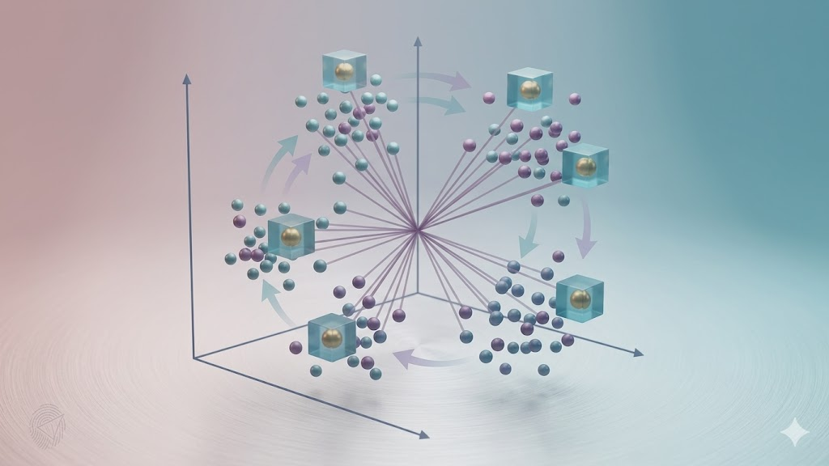
2. Text Embedding & Content Vectors
Represent student interests & web content as numerical 768-dimensional vectors (a Float32Array of 768 numbers)
Content Vector
Interests Vector
. Inputs cached URL’s:
1) Page Title
2) AI-Generated Category
. Output vector is stored in the CategoryCache table
Inputs a weighted representation of the user’s interests array (using text repetition)
Implementation
text-embedding-004 (Google Gemini)

Slide 6


3. Cosine Similarity
Measures how similar the student’s interest vector is to each candidate content vector stored in the CachedCategory table
Produces a score from 0 (completely different) to 1 (identical)

Slide 7
Purpose:
4. Contextual Bandit
Using ML to learn which features lead to better learning outcomes
Exploration
Exploitation
Implementation: LinUCB ML-Based Contextual Bandit
selects whichever arm maximizes predicted reward + uncertainty bonus

Slide 8
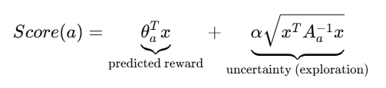
Formula Used To Select A Candidate URL (Arm)
I. Student Context Vector (x)
II. Reward Signal
. Region . School Type . Language
. Proficiency . Interest Score . Learning Preferences
. Visit Duration . Interaction Type
. Completion Status . Student Feedback
III. Exploitation Parameter (α)
IV. Learned Preference Weights (θ)
A tunable parameter balancing exploitation vs exploration
The model’s learned weights that estimate how well a piece of content will perform for a student based on their features

Slide 9

Thank you!

